Slide 1
Database Principles
Constructed by Hanh Pham based on slides from:
“Database Processing, Fundamentals, Design, and Implementation”, D. Kroenke, D. Auer, Prentice Hall
“Database Principles: Fundamentals of Design, Implementation, and Management”, C. Coronel, S. Morris, P.Rob
Relational Databases
(II)
7-<number>

Slide 2
Outlines (of part 2)
Relational Databases (Cont.)
Referential Integrity Constraint
Relational Set Operators
Dictionary, Catalog
Indexes
7-<number>

Slide 3
The Referential Integrity Constraint
A referential integrity constraint is a statement that limits the values of the foreign key to those already existing as primary key values in the corresponding relation.
7-<number>

Slide 4
Foreign Key with a
Referential Integrity Constraint
NOTE: The primary key of the relation is underlined and any foreign keys are in italics in the relations below:
SKU_DATA (SKU, SKU_Description, Department, Buyer)
ORDER_ITEM (OrderNumber, SKU, Quantity, Price,
ExtendedPrice)
Where ORDER_ITEM.SKU must exist in SKU_DATA.SKU
7-<number>

Slide 5
Integrity Rules
Many RDBMs enforce integrity rules automatically
Safer to ensure that application design conforms to entity and referential integrity rules
Designers use flags to avoid nulls
  Flags indicate absence of some value
7-<number>

Slide 6
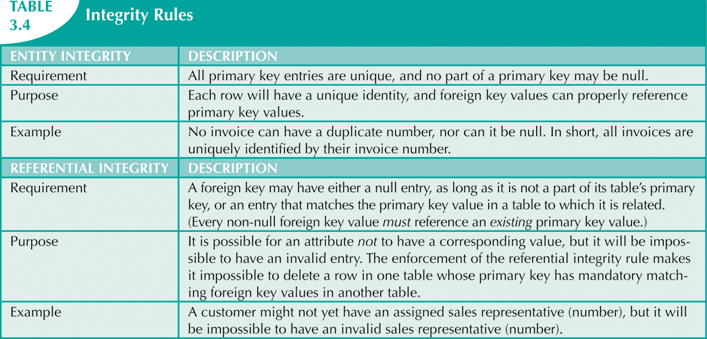


Slide 7
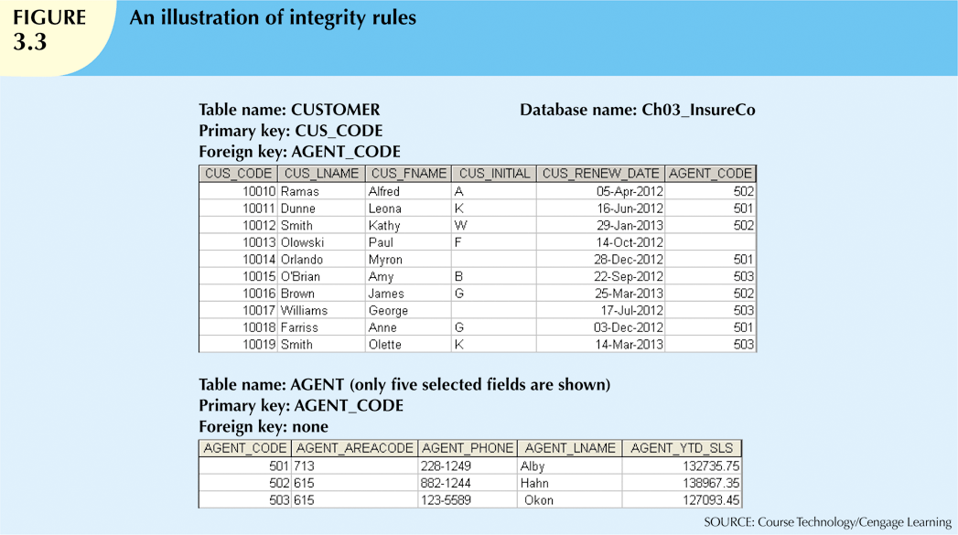

Slide 8
Relational Set Operators
Relational algebra
  Defines theoretical way of manipulating table contents using relational operators
  Use of relational algebra operators on existing relations produces new relations:
SELECT | UNION
PROJECT | DIFFERENCE
JOIN | PRODUCT
INTERSECT | DIVIDE
7-<number>

Slide 9
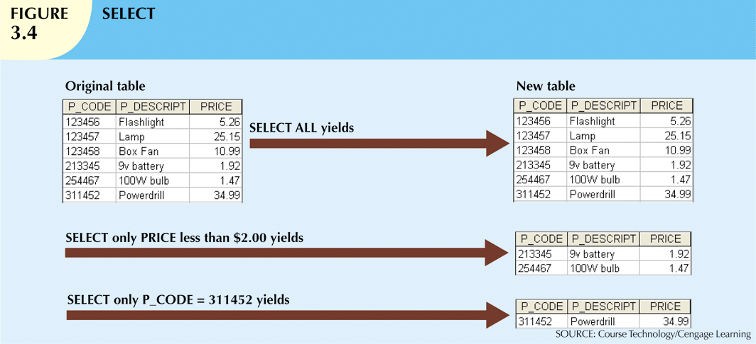

Slide 10
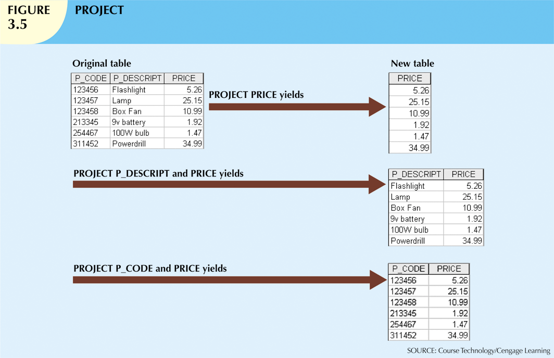

Slide 11
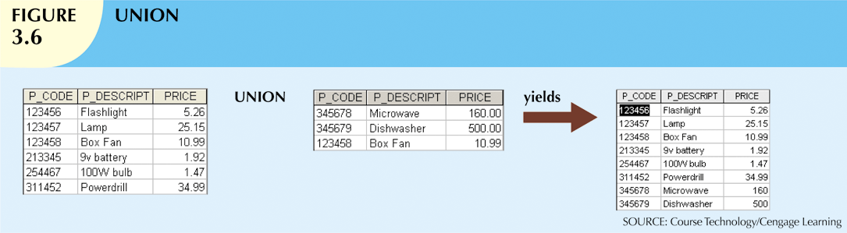
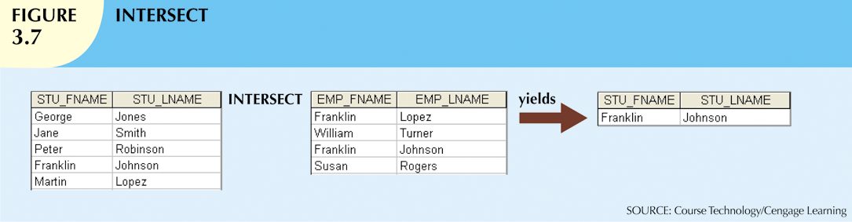

Slide 12
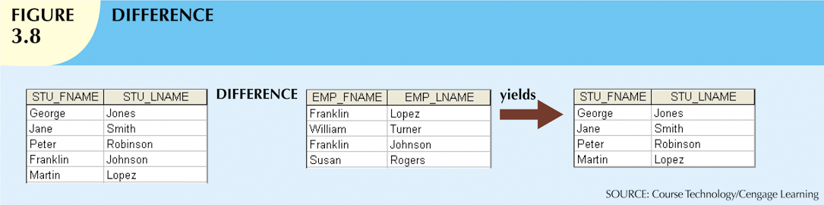
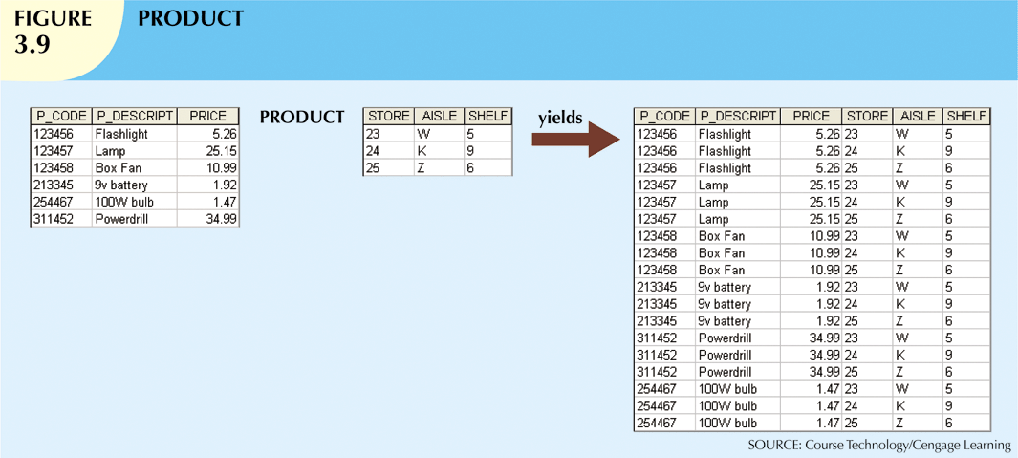

Slide 13
Relational Set Operators
Natural join
  Links tables by selecting rows with common values in common attributes (join columns)
Equijoin
  Links tables on the basis of an equality condition that compares specified columns
Theta join
  Any other comparison operator is used
7-<number>

Slide 14
Relational Set Operators
Inner join
  Only returns matched records from the tables that are being joined
Outer join
  Matched pairs are retained, and any unmatched values in other table are left null
7-<number>

Slide 15
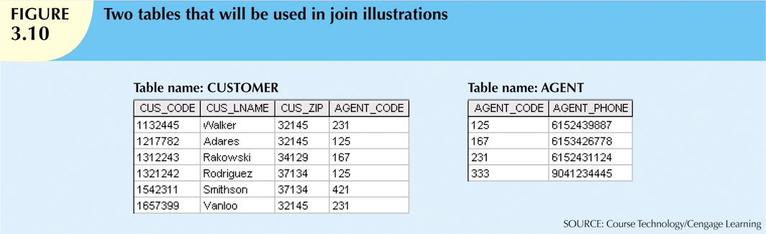
1-<number>

Slide 16
Relational Set Operators
Left outer join
  Yields all of the rows in the CUSTOMER table
  Including those that do not have a matching value in the AGENT table
Right outer join
  Yields all of the rows in the AGENT table
  Including those that do not have matching values in the CUSTOMER table
7-<number>

Slide 17
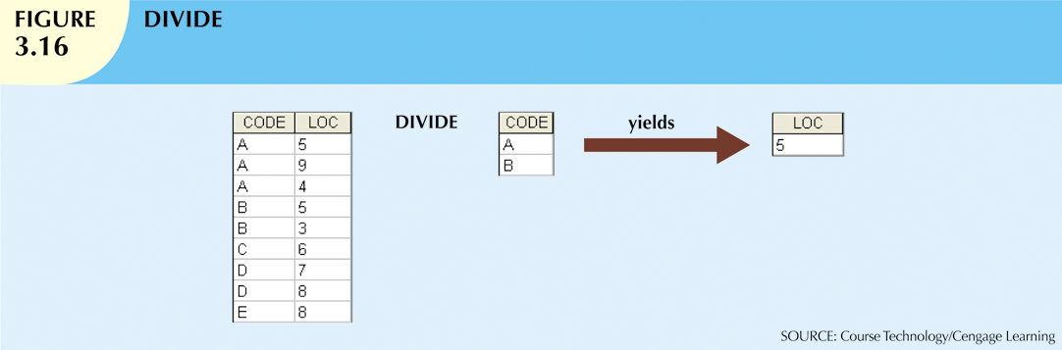
1-<number>

Slide 18
The Data Dictionary and System Catalog
Data Dictionary
  Provides detailed accounting of all tables found within the user/designer-created database
  Contains (at least) all the attribute names and characteristics for each table in the system
  Contains metadata: data about data
System Catalog
  Contains metadata
  Detailed system data dictionary that describes all objects within the database
7-<number>

Slide 19
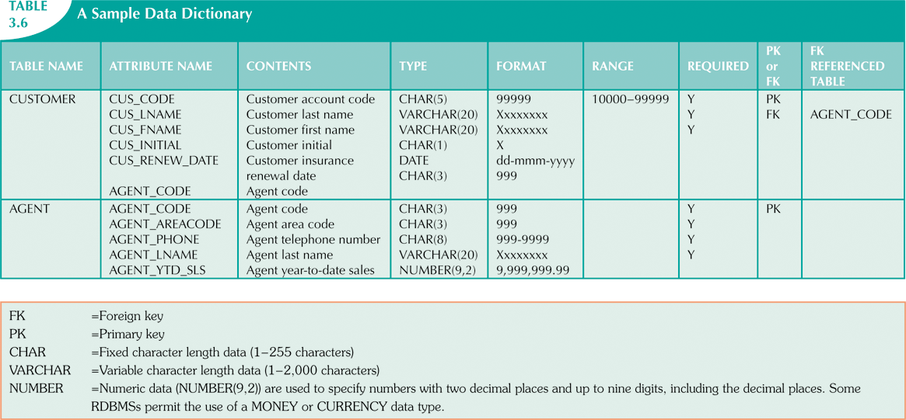

Slide 20
The Data Dictionary and System Catalog
Homonym
  Indicates the use of the same name to label different attributes
Synonym
  Opposite of a homonym
  Indicates the use of different names to describe the same attribute
7-<number>

Slide 21
Relationships within the Relational Database
1:M relationship
  Relational modeling ideal
  Should be the norm in any relational database design
1:1 relationship
  Should be rare in any relational database design
M:N relationships
  Cannot be implemented as such in the relational model
  M:N relationships can be changed into 1:M relationships
7-<number>

Slide 22
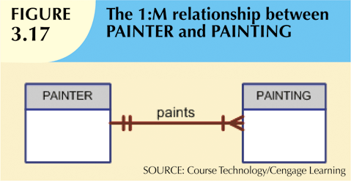
The 1:M Relationship
Relational database norm
Found in any database environment
7-<number>

Slide 23
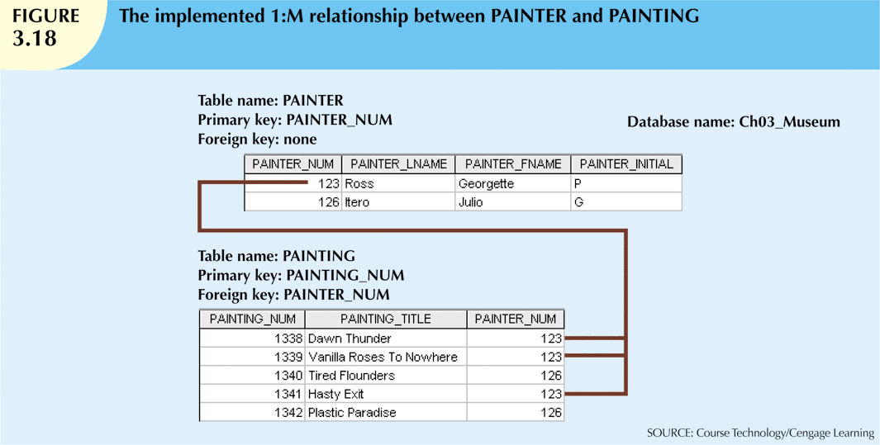

Slide 24
The 1:1 Relationship
One entity related to only one other entity, and vice versa
Sometimes means that entity components were not defined properly
Could indicate that two entities actually belong in the same table
Certain conditions absolutely require their use
7-<number>

Slide 25
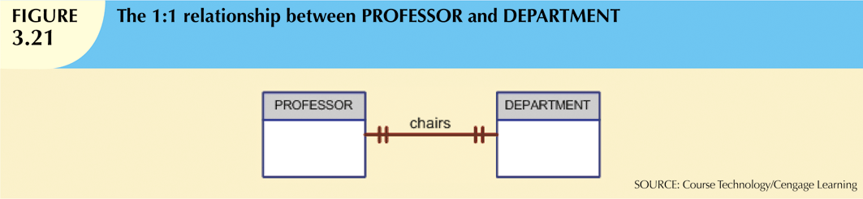

Slide 26
The M:N Relationship
Implemented by breaking it up to produce a set of 1:M relationships
Avoid problems inherent to M:N relationship by creating a composite entity
  Includes as foreign keys the primary keys of tables to be linked
7-<number>

Slide 27
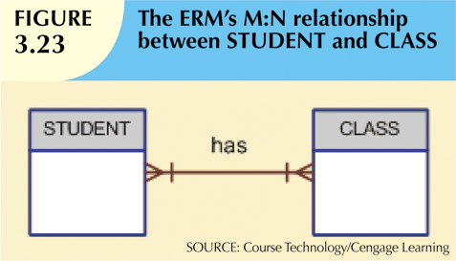

Slide 28
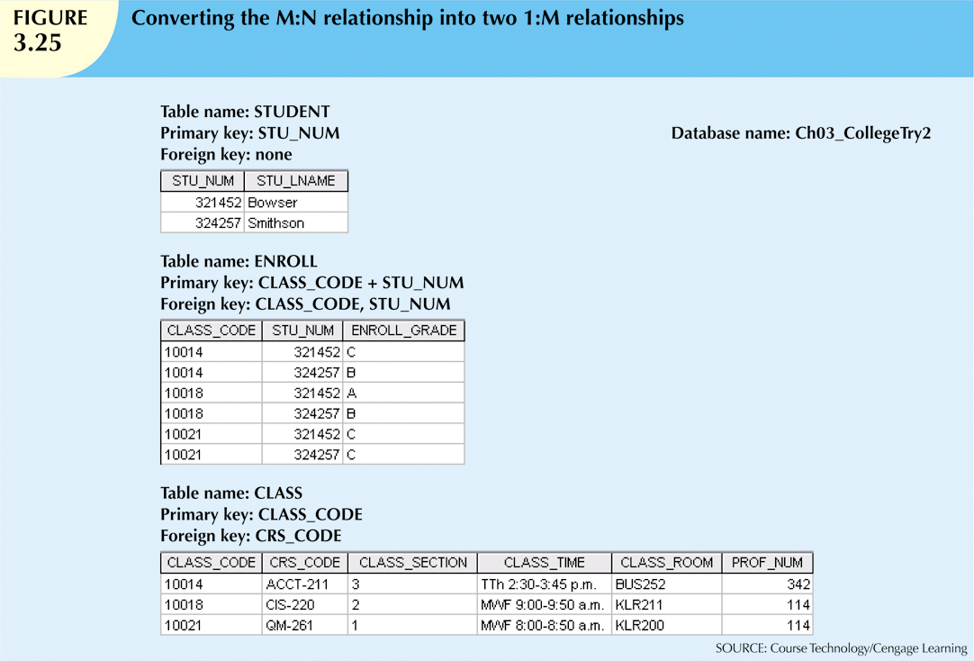

Slide 29

1-<number>

Slide 30
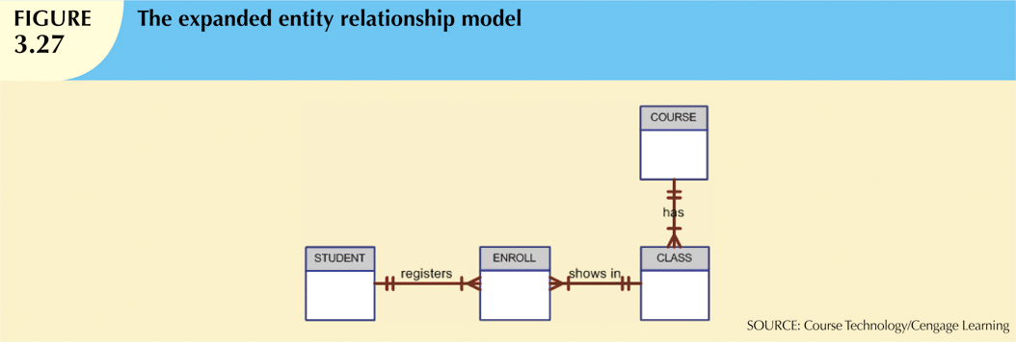
1-<number>

Slide 31
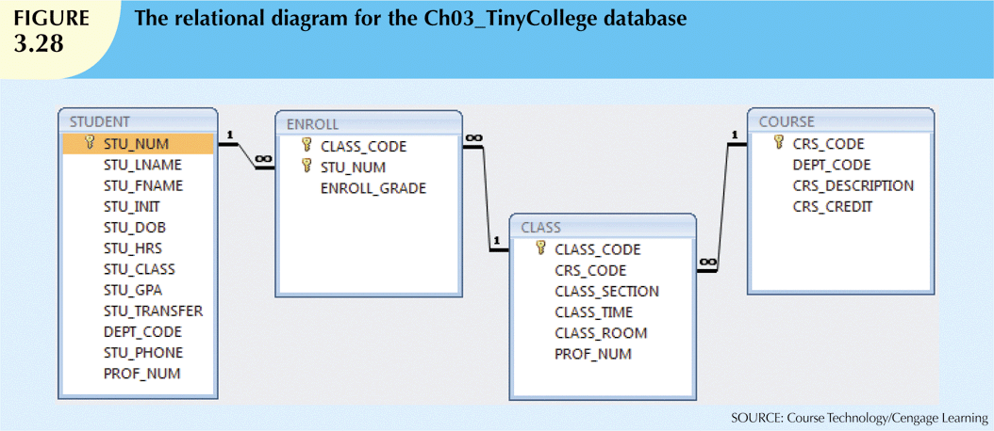
1-<number>

Slide 32
Data Redundancy Revisited
Data redundancy leads to data anomalies
  Can destroy the effectiveness of the database
Foreign keys
  Control data redundancies by using common attributes shared by tables
  Crucial to exercising data redundancy control
Sometimes, data redundancy is necessary
7-<number>

Slide 33
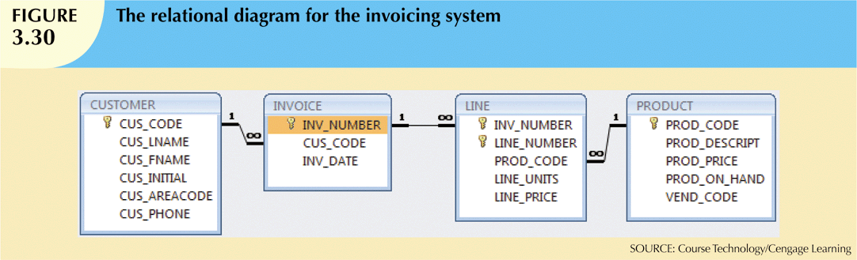
1-<number>

Slide 34
Indexes
Orderly arrangement to logically access rows in a table
Index key
  Index’s reference point
  Points to data location identified by the key
Unique index
  Index in which the index key can have only one pointer value (row) associated with it
Each index is associated with only one table
7-<number>

Slide 35
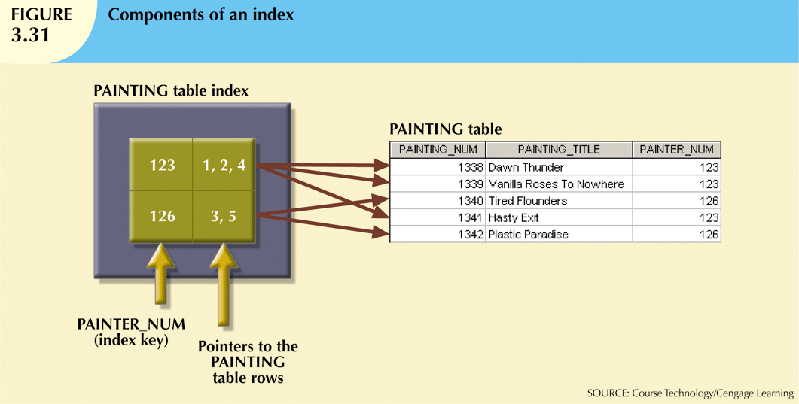

Slide 36
Codd’s Relational Database Rules
In 1985, Codd published a list of 12 rules to define a relational database system
  Products marketed as “relational” that did not meet minimum relational standards
Even dominant database vendors do not fully support all 12 rules
7-<number>

Slide 37
Summary
Tables are basic building blocks of a relational database
Keys are central to the use of relational tables
Keys define functional dependencies
Each table row must have a primary key that uniquely identifies all attributes
Tables are linked by common attributes
The relational model supports relational algebra functions
  SELECT, PROJECT, JOIN, INTERSECT UNION, DIFFERENCE, PRODUCT, DIVIDE
Good design begins by identifying entities, attributes, and relationships
  1:1, 1:M, M:N
7-<number>

